Slide 1
Development of a Locally-Run AI Chatbot for University Information Retrieval

Slide 2
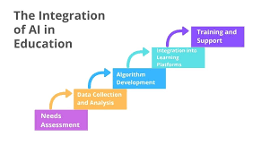
Introduction
Overview of AI advancements and the role of large language models like ChatGPT

Slide 3

Challenges faced by students and faculty in accessing university information

Slide 4
Objectives
• To design and implement a locally-run AI chatbot using Python that can process natural language queries related to university information and course content
• To collect and preprocess data from university websites and course materials to create a domain-specific dataset for training the AI model
• To develop a lightweight machine learning model suitable for running on standard personal computers without requiring high-end hardware.
• To ensure data privacy by performing all computations locally, eliminating the need for cloud-based processing.
• To evaluate the chatbot’s performance in terms of response accuracy, speed, and user satisfaction.
• To make our chatbot as user friendly as possible.

Slide 5
Project Scope
Details on data sources
Language support
Hardware requirements

Slide 6
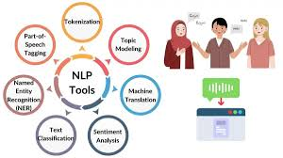
Literature Review

Slide 7
Methodology - Data Collection
Approach to sourcing and curating data from university websites and course materials.

Slide 8
Methodology - Model Development
• Model: A lightweight transformer model
• Training: University-specific dataset
• Tools: Python, PyTorch, Hugging Face Transformers, and NLTK for text processing.
• Hardware: A standard laptop

Slide 9
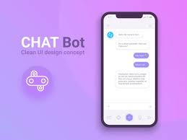
Chatbot Implementation
• Develop a command-line
• Integrate the trained model to process natural language queries and generate responses.
• Implement a retrieval-augmented generation (RAG) approach to combine the model’s knowledge with direct access to the dataset for improved accuracy.

Slide 10
Evaluation
• Metrics
• Testing
• Benchmarks

Slide 11
Resourses
a. Hardware: Personal computers with at least 16GB RAM and Intel i3 processors.
b. Software: Python3.8+, PyTorch, Hugging Face Transformers, Scikit Tools, Tokenizers BeautifulSoup, Scrapy, Tkinter/Flask, Scikit learn PyCharm Community Edition, Visual Studio Code
c. Data: University website and course materials (publicly available).
d. Human Resources: Project team of 3 CSE students, supervised by a faculty advisor.

Slide 12
Expected Outcomes
• A fully functional AI chatbot that runs locally on a standard computer, capable of answering university-related queries with at least 80% accuracy.
• A documented dataset of university and course information, reusable for future projects.
• A user-friendly interface for interacting with the chatbot.
• A technical report detailing the model’s performance, limitations, and future improvements.

Slide 13
THANK YOU

